Slide 1


AI For
Walmart
Team 6
1

Slide 2


Agenda
Executive Summary
4
Situation & Context
5
Recommendations
7
Evidence & Benefits
9
Implementation Roadmap
34
Success Metrics
35
Appendix
36
2

Slide 3
Executive Summary
3

Slide 4








Executive Summary
Question
How can Walmart leverage AI to solve persistent customer experience issues—such as stockouts, slow checkout, and weak personalization—and compete effectively with Amazon, Alibaba, Costco, and emerging AI-native commerce platforms?
Pain Points
Systemic CX Gaps: Customers face recurring friction across store, app, and delivery due to inventory inaccuracies, inconsistent checkout performance, and low-relevance recommendations.
Fragmented Data & Reactive Operations: Identity, inventory, and behavioral signals sit in silos, preventing real-time predictive decision-making. Sparky improves search but does not solve foundational data or supply chain issues.
Competitive Pressure: Amazon and Alibaba operate predictive, autonomous retail systems; TikTok Shop drives AI-native discovery; Costco leads in loyalty and retention through simplicity and trust.
Solution
Framework
Unified AI Predictive Data Core
Autonomous Retail Operations
Predictive & Personalized CX
Agentic Commerce Ecosystem
Merge identity, events, product, and inventory into a real-time decision engine (Identity Graph × Luminate).
Deploy computer vision for shelf accuracy, robotics for fulfillment, and digital twins for predictive planning reducing stockouts, shrink, and operational delays.
Power dynamic loyalty, mission-based recommendations, frictionless checkout, and household-level personalization across all channels.
Build AI agents that plan, bundle, schedule, and execute entire shopping missions groceries, life events, holidays across Walmart’s channels.
4

Slide 5

Situation & Context
The Problem we are trying to solve
Why It Matters Now
Customer pain points persist across store, app, and delivery.
Stockouts and inaccurate inventory undermine trust.
App recommendations lack relevance and continuity.
Sparky improves search but does not fix systemic friction.
Competitors are winning by integrating AI across fulfillment, personalization, and logistics.
Customer expectations for personalization and convenience are accelerating.
Walmart’s data scale is an underleveraged asset.
AI-native competitors (Amazon, TikTok Shop, Alibaba) redefine speed and relevance.
Walmart needs predictive infrastructure, not feature enhancements.
5

Slide 6
Recommendations
6

Slide 7


Our
Proposal
A Four Pillar Srtrategy
Unified AI Predictive Data Core
Real-time identity, preference modeling, and signal orchestration.
Autonomous Retail Operations
AI replenishment, robotics, computer vision, routing optimization, and digital twins.
Predictive & Personalized CX
Context-aware offers, dynamic loyalty, automated replenishment, and personalized storefronts.
Agentic Commerce Ecosystem
Multi-step AI shopping missions, cross-channel integration, and external ecosystem partnerships.
7

Slide 8
Evidence & Benefits
8

Slide 9
COMPETITIVE ANALYSIS
Walmart operates with unmatched scale (240M+ weekly customers) and a rich labeled dataset, giving it the strongest raw AI inputs among U.S. retailers. Its omnichannel presence enables a 360° data flywheel, integrating store + online behavior into unified AI models
WHERE WALMART LAGS
COMPETITOR ADVANTAGE AREAS
MARKET PRESSURE & THREATS
AI adoption is fragmented, with most applications focused on operations, not customer experience.
Personalization remains weaker than Amazon and Target; the app experience is described as plain, repetitive, and less contextual
Organizational barriers siloed data, legacy systems, and slow experimentation, limit rapid AI deployment.
Amazon uses generative AI for product discovery, personalized recommendations, and review summarization.
Alibaba/Cainiao leads in predictive logistics, 72–120 hour global delivery, and IoT-enabled supply chain precision.
Costco, while less AI-intensive, outperforms all major retailers in customer loyalty and retention through its consistent value and high trust, making it the strongest benchmark for long-term customer stickiness in U.S. retail.
Buyer power rising: users demand hyper-personalization, transparency, and instant comparison.
Substitutes increasing: AI shopping assistants, quick-commerce apps, and social commerce integrate shopping into daily digital habits.
Competitor rivalry is now an AI capability battleground, not just scale or price.
9
WALMART’S SCALE GIVES IT THE STRONGEST RAW AI INPUTS IN U.S. RETAIL, BUT COMPETITORS LEAD IN SPEED, PERSONALIZATION, AND PREDICTIVE LOGISTICS MAKING AI CAPABILITY THE NEW BATTLEGROUND.

Slide 10
User Analysis
Who Walmart’s Users Are
Customer Pain Points
01
Core audience: older adults, suburban families, middle-income women, and Walmart+ members.
Digital users (Millennials + Gen Z) drive heavy mobile interaction, often blending online research with in-store trips.
Associates are also key users feeding operational data through mobile tools.
02
In-store: long checkout lines, self-checkout errors, out-of-stock items, limited staff support.
Online: cluttered navigation, weak search relevance, slow delivery/refund cycles.
Emotional drivers include a desire for trustworthy loyalty rewards and reliable real-time information
Behavior Patterns
User Expectations for AI
03
Walmart App is the #1 most downloaded retail app in the U.S. for two years indicating mobile-first expectations.
91.5% of food purchases remain in-store → O2O journeys dominate.
Younger shoppers expect fast digital experiences tracking, personalization, frictionless checkout.
04
Customers want invisible, effort-reducing AI (better search, accurate inventory, fast help) rather than intrusive automation.
High engagement but low trust:
52% plan to use gen-AI for shopping, yet
66% would NOT let an AI purchase for them automatically.
Barriers to Adoption
Implications for Walmart
05
06
Data privacy worries: 58–60% concerned about the misuse of personal data.
Bad AI experiences: 39% abandoned purchases after poor AI interaction.
Low usability confidence: 48% do not know how to use AI tools effectively. Older users fear losing human touch.
AI must solve stockouts, checkout friction, and personalization gaps without overwhelming users.
AI should be assistive, transparent, and unobtrusive, driving seamless omnichannel continuity.
Trust, explainability, and usability are essential for adoption.
10
USERS EXPECT FAST, ACCURATE, LOW-EFFORT AI, BUT WALMART’S CURRENT SEARCH, INVENTORY, AND CHECKOUT EXPERIENCE FALLS SHORT OF THOSE EXPECTATIONS.

Slide 11




USER PERSONAS
NAME | Mary Smith | Kenneth Banks | Mark Collins
USER DESCRIPTION | A 42-year-old suburban homemaker who shops 1–2 times per week, primarily for groceries and household essentials. Relies on Walmart for affordability and consistency. Uses the Walmart app for coupons, price comparisons, and Walmart+ benefits. | A 25-year-old urban professional who frequently shops online for groceries, electronics, and apparel. Comfortable with technology and prefers quick pickup or delivery to fit a busy lifestyle. | A 55-year-old rural shopper who visits Walmart as a primary retailer due to limited local options. Shops mostly in-store for groceries, hardware, and general goods. Uses smartphone apps occasionally but still relies heavily on in-store navigation, staff availability, and printed signage.
MOTIVATION | Keeping household budget under control Getting everything in one trip Reliable low prices and convenient access | Fast, convenient shopping Ability to research and compare products easily Personalized digital deals and exclusive online savings | Access to a broad assortment in a single store Dependable availability of essentials despite fewer local alternatives Good value and fair pricing
FRUSTRATION | Rising grocery costs Stockouts for essentials Time lost juggling family schedules and errands | Slow delivery windows Outdated or inaccurate inventory data Cluttered or hard-to-filter product search results | Long travel time to nearest Walmart Out-of-stock items force return trips Difficulty finding staff or locating items in large stores App features feel overwhelming or unnecessary
NEEDS | Dependable deals and low everyday prices Easy access to digital coupons and savings Clear, accurate inventory information before visiting the store | Reliable real-time order tracking Fast pickup/delivery options App experience that is smooth, intuitive, and personalized | Accurate on-shelf availability before driving to the store Clear in-store navigation or assistance Stable pricing and predictable assortment Simple digital tools rather than advanced features
11

Slide 12
Pillar 1
Unified AI Predictive Data Core
12

Slide 13
Why Walmart Needs a Unified Predictive Data Core
PROBLEM:
TODAY’S SYSTEM IS FRAGMENTED
ROOT CAUSE:
WHY THESE ISSUES EXIST
SOLUTION:
UNIFIED PREDICTIVE DATA CORE
Customer identity is split across app, store receipts, and Walmart+.
Product and inventory truth differ across POS, backroom, and shelf-level signals.
Forecasting relies on batch pipelines → delays real-time decisions.
Personalization logic exists separately in app, web, and store systems.
Because signals don’t connect, AI predictions and recommendations become inconsistent.
No unified identifier linking app, store, and Walmart+ behavior.
Real-time events (POS, app actions, sensors) processed in slow cycles.
Legacy schemas prevent departments from sharing the same “truth.”
Product and inventory systems built independently across channels.
Luminate operates separately from customer identity data.
One identity graph combining Walmart+, app login, and store receipt data.
Real-time pipeline ingesting POS, app clicks, shelf sensors, and fulfillment events.
Single product & inventory truth accessible across all teams.
Connected customer → item → inventory → behavior signals.
Shared foundation for forecasting, personalization, replenishment, and CX tools.
A UNIFIED DATA CORE GIVES WALMART THE CONSISTENT IDENTITY, INVENTORY ACCURACY, AND REAL-TIME SIGNALS REQUIRED FOR PREDICTIVE AI.
13

Slide 14
What Data Walmart Needs for Predictive AI
PREDICTIVE AI RELIES ON FOUR TYPES OF SIGNALS: EVENTS, IDENTITY, PRODUCT & INVENTORY CONTEXT, AND HOUSEHOLD PATTERNS. WALMART GENERATES ALL FOUR TODAY, BUT THEY EXIST IN SEPARATE SYSTEMS.
EVENTS DATA
What’s happening right now
PRODUCT & INVENTORY CONTEXT
What is available
POS transactions (items scanned, quantity, timing).
App behavior: search, clicks, add-to-cart, dwell time.
Shelf sensor updates: product removal, gaps, anomalies.
Fulfillment actions: picking, substitutions, delivery timestamps.
Why it matters: Captures real-time demand and behavior shifts.
Store-level inventory truth combining POS + shelf + backroom.
Product metadata: brand, size, substitutes, pack-size.
Location mapping (aisle, bay, bin).
Why it matters: Predictive AI requires accurate product availability and location.
CONNECTED IDENTITY
Who is taking the action
HOUSEHOLD PATTERNS
What will need next
Walmart+ membership & profile.
App login + session history.
Receipt-linked in-store purchases.
Unified identity graph connecting all touchpoints.
Why it matters: Unlocks personalization and cross-channel continuity.
Purchase cycles for consumables.
Basket patterns (items commonly bought together).
Family-size inference & replenishment window.
Why it matters: Enables proactive recommendations and automated replenishment.
14
PREDICTIVE AI ONLY WORKS WHEN THESE FOUR SIGNALS ARE UNIFIED, ACCURATE, AND AVAILABLE IN REAL TIME.

Slide 15

A Simple 3-Layer System for Predictive Retail
LAYER 1 —
DATA FOUNDATION (Collecting & standardizing signals)
Unified identity across app, store, and Walmart+.
Real-time ingestion pipeline for POS, app, sensor, and fulfillment events.
Standardized schemas for customers, events, inventory, and products.
Store-level “single truth” for product and inventory status.
Impact: All systems operate on the same real-time, accurate signals.
LAYER 2 —
AI DECISION LAYER
(Generating predictions)
Unified forecasting logic for demand & replenishment.
Routing and labor optimization based on predicted workloads.
Household-level need prediction and next-best-action models.
Real-time scoring for search, recommendations, promotions.
Impact: Provides a single “AI brain” powering the entire enterprise.
LAYER 3 —
ACTIVATION LAYER
(Delivering customer-visible value)
More accurate and consistent search results.
Proactive OOS alerts + alternative product suggestions.
Checkout congestion prediction for lane optimization.
Seamless cross-channel experiences (app ↔ store ↔ delivery).
Impact: Customers and associates directly experience predictive intelligence.
The three layers turn raw signals into intelligent decisions and deliver them as real customer and operational value.
15

Slide 16
Identity × Luminate: Walmart’s Predictive Engine
LIMITATIONS TODAY —
Why the system breaks
App behavior, in-store receipts, and Walmart+ profiles stored separately.
Personalization updates run in batch, delaying relevance.
Inventory, behavior, and fulfillment signals not synchronized.
Luminate insights not connected to individual customer identity.
Search, recommendations, and promotions inconsistent across channels.
IDENTITY × LUMINATE — The Predictive Engine
Unified identity graph connects Walmart+, app login, and POS receipts.
Luminate adds demand, supply, assortment, and substitution logic.
Combined, they provide real-time awareness of who the customer is and
what is happening across the store ecosystem.
Enables next-best-action in search, recs, promotions, replenishment, and labor.
Becomes a single decision engine across CX, marketing, and operations.
IDENTITY GRAPH
(who the costumer is)
LUMINATE SIGNALS
(what the system knows)
Linking identity with Luminate unlocks a real-time, predictive decision engine across customer and operations.
16

Slide 17
Pillar 2
Autonomous Retail Operations
17

Slide 18

The Execution Gap
Our Solution: Operational AI
Our three step strategy involves:
1. The Eyes: Computer Vision for Real-Time Visibility
Deploying computer vision provides real-time insights into inventory and shelf conditions, eliminating unreliable manual checks and reducing phantom inventory.
2. The Hands: Robotics for Automated Fulfillment
Introducing robotics automates repetitive tasks like inventory movement and shelf replenishment, enhancing efficiency, speed, and accuracy while reducing labor costs.
3. The Brain: Digital Twins for Predictive Simulation
Developing "digital twins" of stores and supply chains enables predictive simulation. This "brain" analyzes data from "eyes" and "hands" to anticipate demand, identify bottlenecks, and optimize operations proactively.
The Interface Trap: The "Phantom" Disconnect
The focus on digital interfaces overlooks backend inefficiencies, primarily "phantom inventory” the gap between reported stock and physical reality. Manual inventory checks average only ~85% accuracy, leading to frequent discrepancies. Customers using our app or Sparky are told items are "In Stock" but find empty shelves, eroding trust. This "phantom inventory" causes 80% of out-of-stock situations, rendering digital efforts irrelevant if basic product availability fails.
The Competitor Benchmark
Leading retailers have closed this gap with operational automation:
Amazon: Uses over 1 million robots, ensuring precise inventory management and superior customer fulfillment.
JD.com: Achieves 90% same-day delivery with sophisticated automation, operating at a low 6.5% fulfillment expense ratio.
Walmart cannot win the AI race purely at the interface level. While competitors like Amazon utilize 1 million robots to guarantee execution, Walmart continues to rely on manual checks with only 85% accuracy. To truly deliver on Sparky's digital promise, we can implement the "Brain, Hands, and Eyes" operational strategy to fundamentally fix it’s backend reality and bridge the execution gap.
18

Slide 19
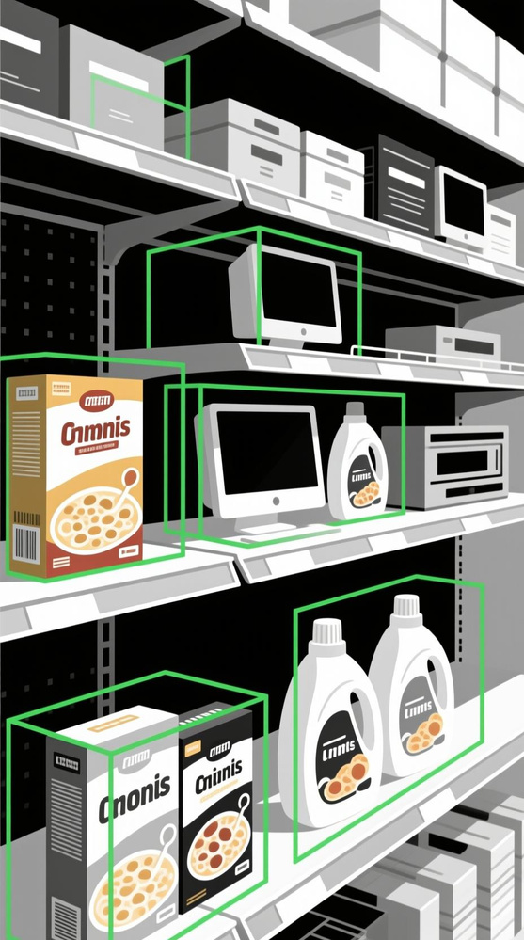



Strategy A: The "Eyes"
The "Data Lag" Problem: Manual Inputs
Current inventory data relies on store associates manually scanning items with handheld devices. This periodic process (once per day/shift) creates "blind spots" between scans.
The "Always-On" Upgrade: Computer Vision
We deploy shelf-edge cameras and roaming autonomous units to convert physical shelf reality into a real-time digital feed.
Technical Specifications:
Edge AI Architecture: Video is processed locally on-chip, ensuring customer privacy (no facial storage) and zero-latency alerts.
Precision: Computer Vision uses Bounding Box detection to achieve 99.5% inventory accuracy, virtually eliminating phantom inventory.
Performance Metrics:
Accuracy: Limited to 85-90% due to human error and timing gaps.
Latency: Stockouts are detected after they occur (reactive), often only when a customer cannot find an item.
Security: Theft is only identified during physical inventory counts, often weeks after the event.
Manual processes give us a snapshot of inventory; Computer Vision gives us a video feed. By moving to Edge-based processing, we achieve 99.5% accuracy without compromising customer privacy. This real-time data layer is the foundational input required for the AI-driven replenishment in Strategy B.
19

Slide 20
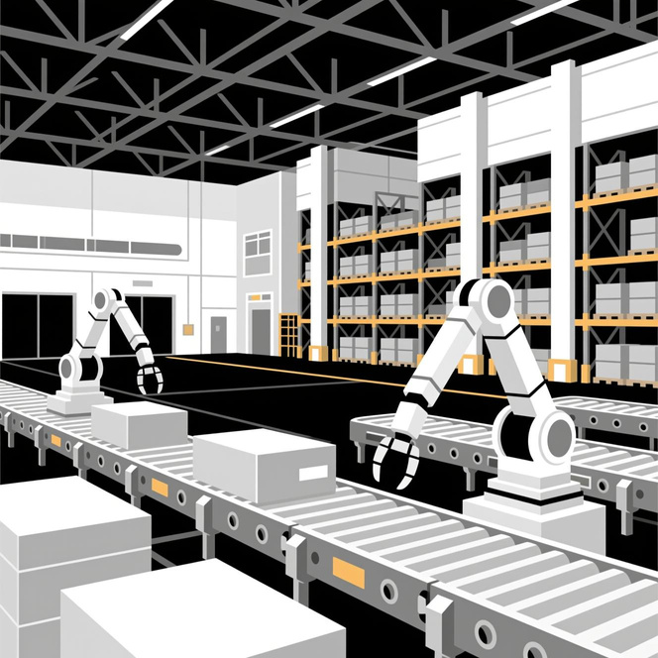
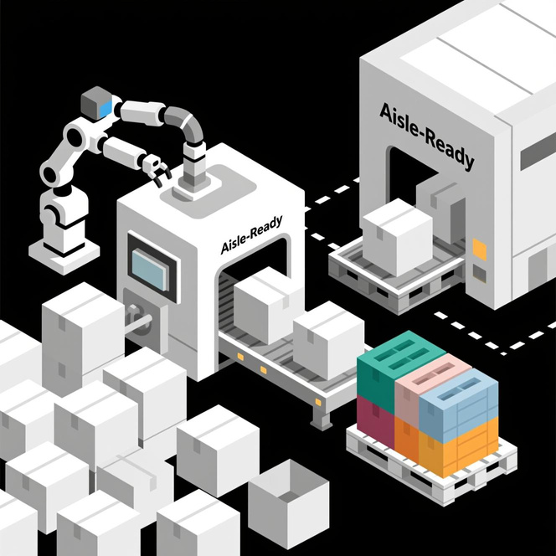

Strategy B: The "Hands"
Strategic Infrastructure (The Asset)
To match Amazon’s delivery speed, Walmart can move it’s fulfillment closer to the customer by converting backrooms into automated nodes.
Operational Mechanics (The "Aisle-Ready" Logic)
Unlike traditional random loading, Symbotic robots ingest inventory and re-palletize it based on the specific layout of the destination store.
Scale & Deployment
Capital Injection: $520 Million investment (Jan 2025) to acquire and scale the "Advanced Systems" unit.
Network Topology: High-density rollout across 400 Accelerated Pickup & Delivery (APD) centers using modular AS/RS (Automated Storage & Retrieval System) architecture.
Strategic Shift: Transitions from "Regional Distribution" (slow, labor-dependent) to "Micro-Fulfillment" (fast, machine-scale), decoupling fulfillment speed from labor availability.
Performance KPIs
Singulation & Buffering: High-Density Buffering singulates cases, increasing processing velocity by 30%.
Robotic Fleet: Autonomous Mobile Robots (AMRs) execute proprietary palletizing algorithms independent of fixed conveyor paths.
Output Precision: "Tetris-style" stacking algorithms build store-specific pallets sorted by aisle, reducing manual down-stacking labor by 50%.
This strategy closes the execution gap by connecting Vision (Strategy A) to Action (Strategy B). By feeding real-time computer vision data directly into Walmart’s existing $520M Symbotic infrastructure, it can shift from "schedule-based" restocking to "demand-based" autonomous fulfillment, reducing lead times by 30% and ensuring the shelf matches the App.
20

Slide 21



Strategy C: The "Brain"
Digital Twins transform raw data into a predictive operating environment, preventing failures before they impact real-world operations.
The "Physical Latency" Problem
Currently, operations teams react to bottlenecks after they occur. This "trial-and-error" approach in the physical world is costly and risks customer trust.
The "Virtual Sandbox" Solution
Walmart can implement high-fidelity Digital Twins as dynamic virtual replicas of our supply chain nodes to stress-test operations before execution.
Operational Risks
Technical Specifications
Static Planning
Store layouts cannot adapt to sudden demand surges (e.g., Hurricanes, Black Friday).
Inefficient Allocation
Labor is scheduled based on historical averages, leading to overtime or under-staffing.
Failure Point
Bottlenecks are discovered only when lines are long or deliveries are late.
Data Ingestion
Aggregates real-time streams from Strategy A (Vision) and Strategy B (Robotics) to update the model instantly.
Scenario Modeling
Simulates high-stress events (e.g., "Category 4 Hurricane Supply Shock") 24 hours in advance.
Benchmark
Leveraging NVIDIA Omniverse architecture, similar to Lowe's, to visualize interaction data without physical disruption.
Digital Twins allow Walmart to fail in simulation so we succeed in reality. By shifting from reactive firefighting to predictive stress-testing, we can identify bottlenecks before they occur, reducing operational costs by 30-40% and ensuring the "Hands" and "Eyes" are always deployed efficiently.
21

Slide 22
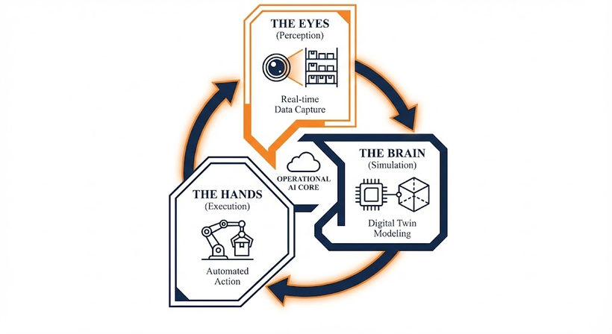
Operational Excellence as the Foundation of Loyalty
How Autonomous Operations Drive Retention
Customer satisfaction is not just about a friendly interface; it is about reliability. By introducing automation to it’s backend, Walmart can directly influence the primary drivers of Net Promoter Score (NPS).
The Value Chain
Trust (Availability): Strategy A (Vision) eliminates "Phantom Inventory," ensuring that when Sparky says "In Stock," it is actually there.
Speed (Convenience): Strategy B (Robotics) reduces order processing from 4 hours to 1 hour, directly meeting the "Quick-Commerce" expectation.
Resilience (Consistency): Strategy C (Digital Twins) prevents service failures during peak demand, protecting brand reputation.
Alignment with Project Scope
This strategy directly answers the core friction points identified in the Project Scoping Document:
Objective 1: "Product Availability" → Solved by: Computer Vision (99.5% Accuracy) replacing manual checks.
Objective 2: "Checkout & In-Store Efficiency" → Solved by: Aisle-Ready Pallets reducing floor congestion and labor distraction.
Objective 3: "Labor Challenges" → Solved by: Automated fulfillment liberating 50% of associate time for customer service.
Walmart cannot build a Predictive Customer Experience (Pillar 3) on a Reactive Supply Chain. Autonomous Operations provide the necessary "Physical Stability" required for AI to function. By solving the execution gap, we convert Walmart's scale from a logistical challenge into a competitive moat, delivering the reliability that drives long-term retention.
22

Slide 23
Pillar 3
Predictive & Personalized CX
23

Slide 24




The Loyalty Brain: Real-Time Prediction Engine
The Problem:
Today's Reactive Loyalty
Our Solution:
Real-Time Loyalty Brain
Loyalty works as simple transactional earn-and-burn
No real understanding of customer intent or lifecycle state
Points awarded without insight into predicted value or churn risk
Missing early-warning system for at-risk customers
Decisions based on historical patterns, not forward predictions
Predict Behavior
Personalize Offers
A predictive loyalty brain turns Walmart’s data into always-on intelligence that watches how customers buy, browse, and engage, then predicts what they’ll buy next, basket size, and churn risk. Instead of reacting after they leave, it triggers the right message at the right moment so Walmart’s data finally powers smart, real-time decisions 24/7
Engage before they leave
Walmart’s current loyalty program reacts too late, giving competitors a 60-90 day head start. A predictive, unified loyalty brain can score every interaction, intervene early, and convert at-risk shoppers and boost loyalty engagement by 30-40%
24

Slide 25

The Rewards Brain
The Problem:
Static Rewards for Everyone
Our Solution:
Dynamic Reward Orchestration
All customers in same tier receive identical rewards
One-size-fits-all points system ignores individual preferences
Rewards don't account for customer value, sensitivity, or elasticity
Manual calendar-based planning, not data-driven optimization
Misaligned incentives waste budget on low-ROI customers
No feedback loop to adjust based on performance
Auto-
Optimizing
Rules
Behavior-Based Scoring
Category & Elasticity Tuning
Right now, loyalty tiers deliver identical rewards but customers crave personalized ones like points, item discounts, bundles, or faster delivery. A dynamic rewards engine selects the optimal incentive in real-time, learns from performance, and auto-adjusts for sales impact, low inventory, and engagement. This drives higher ROI, true personalization, and rewards that convert.
Reward Personalization
Static points and tiers limit personalization, but a real-time, behavior-driven reward engine can auto-tune incentives per customer by turning reward spend into a precision tool, boosting redemptions by 15-25%, and cutting waste on low-ROI shoppers
25

Slide 26

Household Personalization Engine
The Problem:
Individual-Only Personalization
Our Solution:
Household Graph OS
Personalization stops at individual level, ignores household dynamics
Miss life-stage signals (new baby, school, elderly care)
Family decisions treated as separate transactions
No identity stitching across devices and payments
Leave wallet growth on the table
Unified Household Identity
Household Wallet Growth
Life-Stage Detection
Households shop as units, not individuals. A household graph unifies identities, detects family moments (new baby, back-to-school), and targets total wallet growth. Result: 20-30% uplift with offers that match the real decision-maker—the family.
Family-Stage Offers
Joint Basket Optimization
Walmart currently views shoppers as individual transactions, but household graphs reveal shared life-stage moments. By detecting events like new babies or back-to-school, Walmart can optimize family baskets and drive 20-30% wallet growth by shifting from individual acquisition to full household lifetime value
26

Slide 27

The Mission Brain
The Problem:
Calendar-Based Seasonal Planning
Our Solution:
Event Orchestration Engine
Seasonal events treated as fixed calendar dates, miss regional timing differences
One-size-fits-all campaigns ignore household-level event missions
No early detection of buying signals (searches, list-building, category)
Inventory and replenishment disconnected from actual demand patterns
Competitors capture early-season shoppers before Walmart pivots
Mission
Detection
Experience Auto-Switching
Supply Chain Coordination
People shop around life events like back-to-school, moving, or new babies, yet Walmart runs fixed seasonal campaigns ignoring family and regional differences. An event engine detects early signals backpack searches, etc, auto-adapts the app with lists/bundles, and preps inventory. Walmart gets ahead of the rush with unified predictions coordinating pricing, promotions, and stock across channels.
Event-Aware Pricing
Regional Timing
Fixed seasonal calendars only give snapshots, but real-time mission detection spots households entering key missions weeks early. By orchestrating inventory, logistics, and experiences around predicted missions, Walmart can shift to mission-driven fulfillment, cutting lead times by 30% and boosting AOV by 20%+
27

Slide 28
The Omnichannel Brain
The Problem:
Fragmented Channel Silos
Our Solution:
Unified Preference Graph
Customer data scattered across web, app, store, media, and social
No unified identity, linking all touchpoints and interactions
Each channel makes independent decisions, creating conflicting messages
Preferences inferred separately per channel, wasting insights
Lost personalization opportunities across omnichannel journey
Enterprise Identity Graph
Omnichannel Orchestration
Unified Preference Engine
Customers shop across TikTok, Google, app, store, etc. each touchpoint a clue. A multichannel preference graph unifies them into one clear picture, delivering the right product, deal, and channel at the perfect time. Retailers see double-digit revenue gains; Walmart’s data is split. Unify it to power search, ads, promotions, inventory, and AI assistants.
Coordinated Decisions
Graph-Based ML
Channel silos fragment Walmart’s view of customers, but a unified preference graph connects intent and behavior across store, app, and web. With one enterprise-wide identity layer orchestrating search, ads, inventory, and fulfillment, Walmart can deliver seamless journeys and unlock double-digit revenue uplift
28

Slide 29
Pillar 4
Agentic Commerce Ecosystem
29
Notes:
Our fourth pillar is the Agentic Commerce Ecosystem. This pillar takes Walmart beyond basic, reactive AI tools like Sparky and moves toward fully autonomous, goal-driven retail experiences.
Let's discuss this further in the next slide
Instead of customers having to search repeatedly, plan manually, and resolve issues on their own, AI works quietly in the background to plan, coordinate, and complete the entire shopping journey across stores, the app, pickup, and delivery. The goal is to reduce effort for the customer while increasing speed, accuracy, and overall convenience.

Slide 30

Agentic Commerce Ecosystem
Walmart is evolving from reactive tools like Sparky to autonomous, goal-driven AI systems that proactively manage customer needs.
AI agents plan, bundle, replenish, schedule, and optimize shopping tasks end-to-end.
Systems predict household needs and automate journeys for groceries, events, and daily routines.
Experiences operate as one unified ecosystem across store, app, web, delivery, and Walmart+.
Integrations with social commerce, partner apps, and assistants like Alexa and Google create seamless omnichannel engagement.
Multi-agent coordination aligns inventory, promotions, search, and fulfillment to ensure mission-level accuracy and reliability.
Walmart is evolving into an autonomous retail ecosystem where AI agents anticipate needs and seamlessly execute end-to-end shopping journeys across every channel.
30
Notes:
Today, most retail AI is reactive. It only responds when customers ask something.
Agentic commerce is different. It is goal-driven AI that acts on behalf of the customer.
As I said, Instead of searching again and again, the system plans, schedules, bundles, and executes shopping automatically.
It works across store, app, pickup, and delivery as one connected system.
This is how Walmart moves from “assistive AI” like Sparky to autonomous retail experiences.

Slide 31


Capabilities & Outcomes
⚙️
🛒
🌐
🎛️
Autonomous Task Engines
AI automates planning, bundling, replenishment, scheduling.
Dynamic baskets adjust to household signals and local demand.
AI Shopping Missions
Weekly groceries, event planning, seasonal bundles.
Personalized, context-aware workflows across channels.
Multi-Agent Coordination Layer
AI synchronizes supply, promotions, search, and personalization.
Inventory availability aligns with mission-level workflows.
Ecosystem Integrations
Social commerce
External AI assistants (Alexa, Google)
Partner apps
🎛️
Unified Customer Profiles
Centralized profiles combine behavior across store, app, web, and delivery.
AI tailors offers, timing, and missions to individual routines and preferences.
Fulfillment Optimization Layer
AI chooses the best fulfillment mode based on cost, speed, and inventory.
Routes orders efficiently across stores, dark stores, and delivery partners.
Real-Time Personalization Engine
AI generates personalized bundles, promotions, and content for each mission.
Search and recommendations adapt instantly to context and customer intent.
31
Walmart’s autonomous retail vision is powered by AI engines, coordinated shopping missions, ecosystem integrations, and multi-agent workflows that seamlessly plan, personalize, and execute every step of the customer journey.
Notes:
Autonomous task engines handle routine planning like restocking and scheduling.
AI shopping missions manage weekly groceries, events, and seasonal bundles.
Ecosystem integrations connect Walmart with social commerce and external assistants.
Multi-agent coordination synchronizes inventory, promotions, and personalization.
The outcome is a self-driving retail experience that reduces effort for customers and increases relevance.

Slide 32
Human-Centered AI Principles for Walmart
Trust Before Technology
Remove Friction Across the Journey
Ensure Omnichannel Continuity
Build Ethical + Emotional AI
Users accept AI only when it feels transparent, predictable, and respectful.
Perception gap: AI seen as surveillance or automation, not help.
Required: Explainable AI (“Why this offer,” “Based on past orders”).
Goal: Build confidence through clarity, not novelty.
Priority: Reduce effort, not add features.
Checkout: Adaptive queue management + predictive lane opening.
Stock: Live CV/IoT availability surfaced in-app.
Search: Intent-driven queries, not keywords.
Delivery: Predictive routing + early delay alerts.
Unified identity graph updated in real time across store, app, and web.
Cart, rewards, and recommendations persist across pickup, delivery, in-store.
Single loyalty/payment layer with no re-authentication.
Outcome: Customer feels recognized, not tracked.
Guardrails: Bias testing, fairness dashboards, explicit consent, opt-out.
Emotional layer: Detect friction signals; intervene with support, not upsells.
Tone: Human, simple, reassuring.
Walmart’s human-centered AI builds trust, reduces effort, and creates a consistent experience across store, app, and delivery. Transparent recommendations, predictive checkout, and ethical data use improve satisfaction and retention, shifting Walmart’s identity toward a more personal and dependable brand..
32
Notes:
Lets talk about AI and human trust
Customers only trust AI when it feels transparent, predictable, and respectful.
AI should remove friction, not add complexity.
Checkout, stock visibility, search, and delivery should feel automatic and smooth.
Omnichannel continuity is critical. The customer should feel recognized across store, app, and delivery.
Ethical and emotional AI matters. Customers want clarity, consent, and a human tone.
This ensures AI feels like support, not surveillance.

Slide 33
Implementation Plan
&
Success Metrics
33

Slide 34


24+Month AI-OS Implementation Roadmap
Phase 1
(0-6Months)
Phase 3
(12-18 Months)
Phase 5
(24+Months)
5
1
3
Build the Data Core
Activate Predictive CX
Scale & Optimize
Unify customer identity, product, and inventory data
Enable real-time event streams across app, POS, CV, and logistics
Establish Walmart’s AI-OS foundation
Launch predictive loyalty and dynamic offers
Enable personalized storefronts and automated replenishment
Introduce event-driven commerce flows
Roll out AI-OS capabilities across all stores and channels
Strengthen governance, explainability, and data controls
Continuously optimize models and enterprise KPIs
Phase 2
(6-12 Months)
2
Phase 4
(18-24 Months)
4
Automate Operations
Launch Agentic Commerce
Deploy computer vision shelf monitoring
Expand robotics and micro-fulfillment automation
Build digital twins for store + DC operations
Deploy AI shopping missions (groceries, holidays, life events)
Enable autonomous task engines for planning & bundling
Establish multi-agent coordination across supply, pricing, and CX
34
Notes:
Phase 1 builds the unified data core across identity, product, and inventory.
Phase 2 automates operations using computer vision and robotics.
Phase 3 activates predictive customer experience with loyalty and personalization.
Phase 4 launches full agentic shopping missions.
Phase 5 focuses on scaling, governance, and continuous model optimization.
This creates a safe and structured transition to autonomous commerce.

Slide 35

Success Metrics
Customer Experience, Operational & Business Success Metrics after Walmart adopts the AI Transformation
CSAT Score ↑
Personalization Engagement ↑
01
05
CTR, repeat interactions, tailored journeys
Increase from 70 to 78+
Predictive Journey Completion ↑
Fulfillment Speed ↑
02
06
AI-powered baskets and missions
(Target: +15–25%)
Restocking Efficiency ↑
ROI on AI Investments
03
Through Computer Vision & AI Robotics
07
Tied to reduced waste + improved margin mix
Customer Retention
Operational Cost-to-Serve ↓
04
Track repeat engagement and loyalty rates demonstrating sustained customer satisfaction.
08
(Target: –10–15%)
35
Notes:
SLIDE 5 — Success Metrics
We track stockout reduction using real-time inventory and predictive replenishment.
We measure predictive journey completion through AI-driven baskets.
Restocking efficiency improves through computer vision and robotics.
Customer retention reflects long-term loyalty growth.
Personalization engagement shows experience quality.
Fulfillment speed and operational costs show financial impact.
Together, these metrics ensure AI delivers real business value, not just innovation.
CLOSING LINE (Optional, 1 sentence)
Agentic commerce allows Walmart to shift from reacting to customer needs to anticipating and fulfilling them automatically, at scale, with trust.

Slide 36
Appendix
About Amazon. (2024). How Amazon is using generative AI to improve product recommendations and descriptions.
Instacart Company Blog. (2023). Bringing inspirational, AI-powered search to the Instacart app with Ask Instacart.
Microsoft Official Blog. (2024, January 9). Walmart unveils new generative AI-powered capabilities for shoppers and associates.
TechCrunch. (2024, January 9). Walmart debuts generative AI search and AI replenishment features at CES.
TikTok Newsroom. (2023). Introducing TikTok Shop in the US.
Walmart Corporate News. (2024, March 14). Walmart Commerce Technologies launches AI-powered logistics product.
Walmart Corporate News. (2024, October 9). Walmart reveals plan for scaling artificial intelligence, generative AI, augmented reality and immersive commerce experiences.
CNBC. (2024). Walmart Connect AI-driven ad revenue and personalization.
arXiv paper. (2024). Semantic Retrieval at Walmart.
Consumers are satisfied with supermarkets, but digital cracks emerge
ACSI® Retail and Consumer Shipping Study 2025
Sam's Club beats Costco – thanks to tech
McKinsey & Company. (2024). LLM to ROI: How to scale generative AI in retail. McKinsey & Company.
eMarketer. (2025). Walmart inks partnership with OpenAI to sell products through ChatGPT. Insider Intelligence.
eMarketer. (2025). What the rise of GenAI assistants means for retail media. Insider Intelligence.
Deloitte. (2025). How Agentic AI is transforming commerce and payment. Deloitte US.
McKinsey & Company. (2025). From blueprint to breakthrough: How AI and automation can transform the consumer enterprise. McKinsey & Company.
36

Slide 37
Appendix
Predictive-loyalty / churn-prediction / “loyalty brain” - SpringerLink
Dynamic Rewards Engine / AI-driven incentive personalization - ScienceDirect
Household-level / Omnichannel Personalization - Sydney Academics
Event-Driven Commerce & Real-time Decisioning - arXiv
JD.com Fulfillment Efficiency (Nov 2024/2025)
Amazon Robotics Scale (Aug 2025)
Walmart & Symbotic Automation (Jan 2025)
Symbiotic press release (Jan 2025)
Computer Vision Inventory Accuracy (Nov 2025)
Lowe’s Digital Twin Strategy (Case Study)
ChatGPT(Image Generation)
Google Gemini(Image Generation)
Thunderbolt
Business model analyst
Business Dasher
Walmart data ventures
In-Store Retail Media 2025.
Retail and Consumer Shipping Study 2025
State of the Consumer 2025: When Disruption Becomes Permanen
Retail Dive / YouGov (2025)
xcube Labs (2025)
Fibre2Fashion (2025)
37

Slide 38
THANK YOU
38
Notes:
Our fourth pillar is the Agentic Commerce Ecosystem. This pillar takes Walmart beyond basic, reactive AI tools like Sparky and moves toward fully autonomous, goal-driven retail experiences.
Let's discuss this further in the next slide
Instead of customers having to search repeatedly, plan manually, and resolve issues on their own, AI works quietly in the background to plan, coordinate, and complete the entire shopping journey across stores, the app, pickup, and delivery. The goal is to reduce effort for the customer while increasing speed, accuracy, and overall convenience.

